Slide 1
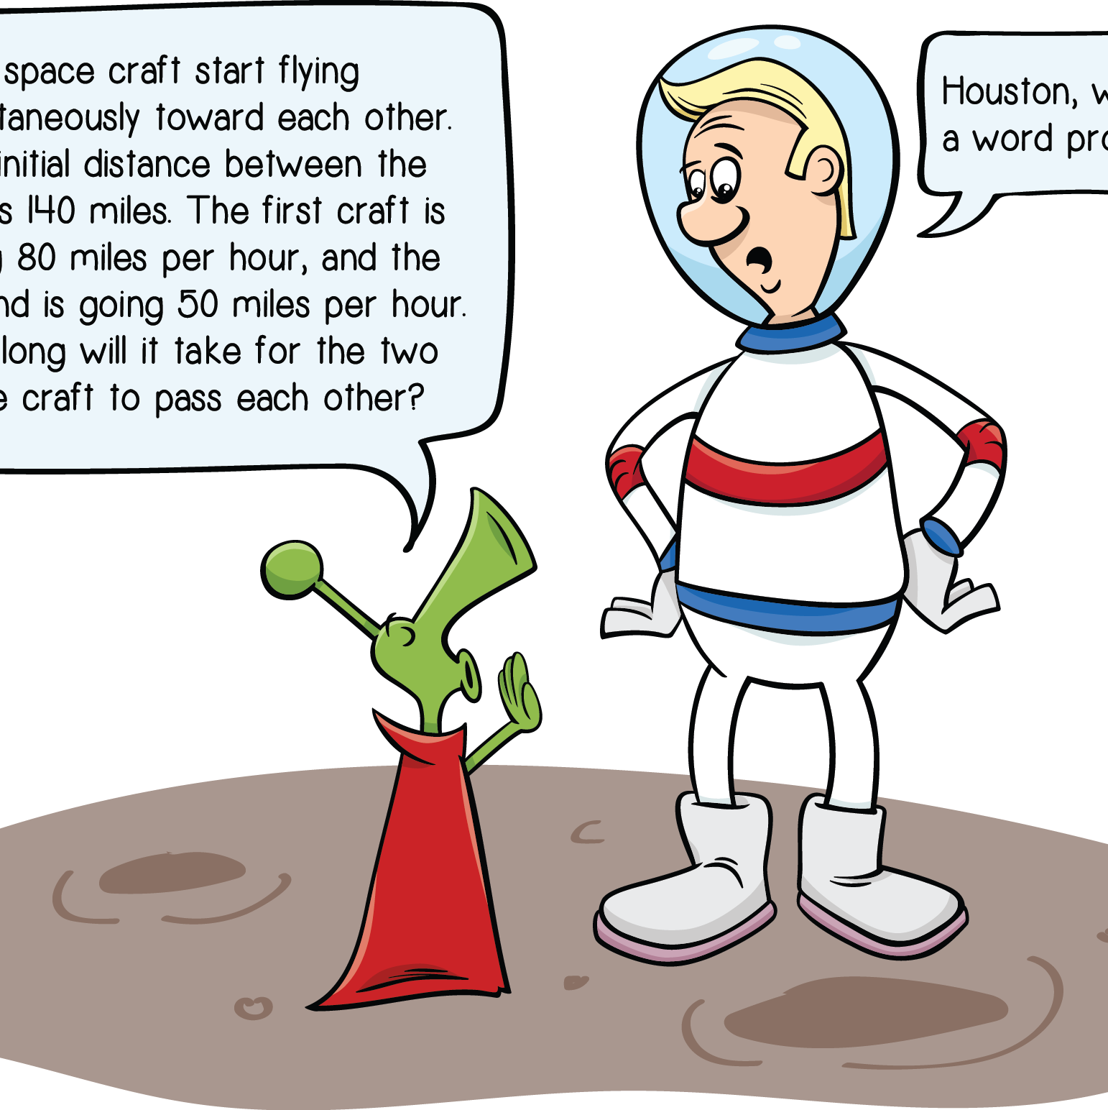
Solving Equations: Word Problems
Entrance Ticket
Learning Targets
Quick Check
Translating Math Statements
System of Equations Word Problems
ACT® Practice
Exit Ticket

Slide 2
3.1 Entrance Ticket
1. On a standardized test, the score starts at 100. For each correct answer, the overall score is increased by 5, and for each incorrect answer, it is decreased by 2. If a question is not answered, it is counted as incorrect. Shelly takes the test and finishes all of the questions. The number of questions she answered correctly is equal to 4 times the number of incorrect answers plus 5. Her overall score is 395. How many questions did she get correct?
A. 15
  B. 18
  C. 65
  D. 85
E. 145
Entrance Ticket
Learning Targets
Quick Check
Translating Math Statements
System of Equations Word Problems
ACT Practice
Exit Ticket

Slide 3
3.1 Entrance Ticket
2. The table below gives the prices for hair perming and coloring services at Hair Today Salon.
Over the course of one week, Celeste, one of the stylists, collected $840 for coloring the hair of 20 different clients (not counting tips). How many of those clients had long hair?
  F. 4
  G. 6
  H. 8
  J. 10
K. 12
Length of Hair | Color | Perm
Short | $30 | $50
Long | $50 | $80
Entrance Ticket
Learning Targets
Quick Check
Translating Math Statements
System of Equations Word Problems
ACT Practice
Exit Ticket

Slide 4
3.1 Entrance Ticket
3. Tad’s sister, Tina, asks him how old he is. Tad tells her that if she squares his age and subtracts 3 times his age, the result is 40. How old is Tad?
  A. 4
  B. 5
  C. 8
  D. 10
  E. 13
Entrance Ticket
Learning Targets
Quick Check
Translating Math Statements
System of Equations Word Problems
ACT Practice
Exit Ticket

Slide 5
3.2 Learning Targets
Translate word problems into mathematical expressions
Solve systems of equations word problems
Self-Assessment
Circle the number that corresponds to your confidence level in your knowledge of this subject before beginning the lesson. A score of 1 means you are completely lost, and a score of 4 means you have mastered the skills. After you finish the lesson, return to the bottom of this page and circle your new confidence level to show your improvement.
Entrance Ticket
Learning Targets
Quick Check
Translating Math Statements
System of Equations Word Problems
ACT Practice
Exit Ticket

Slide 6
3.2 Quick Check
Value
  A number or measurement
Expression
  A group of numbers, symbols, and operations to indicate a value
Equation
  Two mathematical expressions set equal to each other
Coefficient
  The number next to a variable
Combining like terms
  In an equation, the process of simplifying the equation using mathematical operations
Entrance Ticket
Learning Targets
Quick Check
Translating Math Statements
System of Equations Word Problems
ACT Practice
Exit Ticket

Slide 7
3.3.1 Translating Math Statements
Complete the activity in your workbook.
Entrance Ticket
Learning Targets
Quick Check
Translating Math Statements
System of Equations Word Problems
ACT Practice
Exit Ticket

Slide 8
3.3.1 Translating Math Statements
What is the sum of 2 and 5?
  → x = 2 + 5
Together, 2 hamburgers and 1 drink cost $15.
  → 2h + d = 15
What is 15% of 100?
  → x = 0.15 ∙ 100
The sum of 2 numbers is 20.
  → x + y = 20
The difference of 2 numbers is 5.
  → x – y = 5
Entrance Ticket
Learning Targets
Quick Check
Translating Math Statements
System of Equations Word Problems
ACT Practice
Exit Ticket

Slide 9
3.3.1 Translating Math Statements
Complete the activity in your workbook.
Entrance Ticket
Learning Targets
Quick Check
Translating Math Statements
System of Equations Word Problems
ACT Practice
Exit Ticket

Slide 10
3.3.2 Systems of Equations: Word Problems
Complete the activity in your workbook.
Entrance Ticket
Learning Targets
Quick Check
Translating Math Statements
System of Equations Word Problems
ACT Practice
Exit Ticket

Slide 11
Entrance Ticket
Learning Targets
Quick Check
Translating Math Statements
System of Equations Word Problems
ACT Practice
Exit Ticket

Slide 12
3.5 Exit Ticket
Solve the questions on your exit ticket.
Entrance Ticket
Learning Targets
Quick Check
Translating Math Statements
System of Equations Word Problems
ACT Practice
Exit Ticket

Slide 13
3.5 Exit Ticket Review
1. A parking meter in downtown Seattle takes dollar coins and quarters only. When the machine was last emptied, there were 250 coins in it, with a total value of $137.50. Which of the following systems of equations gives the number of quarters, q, and the number of dollar coins, d ?
  A. d + q = 250 and 100d + 25q = 137.50
  B. d + q = 250 and 0.1d + 0.25q = 137.50
  C. d + q = 250 and d + 0.25q = 137.50
  D. d + q = 137.50 and d + 0.25q = 250
  E. d + q = 137.50 and 100d + 25q = 250
Entrance Ticket
Learning Targets
Quick Check
Translating Math Statements
System of Equations Word Problems
ACT Practice
Exit Ticket

Slide 14
3.5 Exit Ticket Review
2. For two consecutive integers, the result of adding double the smaller integer and triple the larger integer is 153. What are the two integers?
  F. 29, 30
  G. 30, 31
  H. 49, 50
  J. 50, 51
K. 76, 77
Entrance Ticket
Learning Targets
Quick Check
Translating Math Statements
System of Equations Word Problems
ACT Practice
Exit Ticket

Slide 15
3.5 Exit Ticket Review
3. In a certain triangle, the longest side is twice as long as the shortest side, and the shortest side is 4 inches shorter than the middle side. If the perimeter of the triangle is 52 inches, how long is the longest side?
  A. 10 inches
  B. 12 inches
  C. 16 inches
  D. 20 inches
  E. 24 inches
Entrance Ticket
Learning Targets
Quick Check
Translating Math Statements
System of Equations Word Problems
ACT Practice
Exit Ticket

Slide 16
This publication, its author, and its publisher are in no way affiliated with or authorized by ACT, Inc. ACT® is a copyright and/or trademark of ACT, Inc.
Learning Targets

